Slide 1

Note: The data and information in this document is reflective of a hypothetical situation and client. This document is to be used for KPMG Virtual Internship purposes only.
Sprocket Central Pty Ltd
Data analytics approach
By Martins Umunna

Slide 2
Note: The data and information in this document is reflective of a hypothetical situation and client. This document is to be used for KPMG Virtual Internship purposes only.
Agenda
Introduction
Data Exploration
Model Development
Interpretation

Slide 3
Note: The data and information in this document is reflective of a hypothetical situation and client. This document is to be used for KPMG Virtual Internship purposes only.
Introduction
Analysis of Top New Customers to drive the most Value for the Organization
This Analysis will focus on the following;
Age Category Vs purchases and profit
Bike related purchases Vs Customer segment
The Highest Selling Brand of Products
Bike Purchases Vs Gender
Purchases vs Job industry category
Product Line and Product Size
States Vs Car Analysis
Summary Table of Target Customers

Slide 4
Note: The data and information in this document is reflective of a hypothetical situation and client. This document is to be used for KPMG Virtual Internship purposes only.
Data Exploration
Age Category Vs Purchases and profit
From the Charts, we can deduce that age category 40-49 makes up the bulk of Purchases and Profit for the past three years.

Slide 5
Note: The data and information in this document is reflective of a hypothetical situation and client. This document is to be used for KPMG Virtual Internship purposes only.
Data Exploration
Bike Purchases VS Customer Segment
From the Charts, we can See that the Mass customer segment has more bike related purchases and also show a correlation with profit. Therefore, marketing campaigns should target this segment more

Slide 6
Note: The data and information in this document is reflective of a hypothetical situation and client. This document is to be used for KPMG Virtual Internship purposes only.
Data Exploration
Highest Selling Brand of Products
The chart shows that the Solex, Giant Bicycles and WearA2B Brands has more purchases respectively and correlates with generating more profit for the business. Therefore, Marketing campaigns should be targeted at promoting these products to target new customers.

Slide 7
Note: The data and information in this document is reflective of a hypothetical situation and client. This document is to be used for KPMG Virtual Internship purposes only.
Data Exploration
Bike Purchases by Gender
The chart depicts that the female gender have purchased more in the last three years more than the males by a slight margin of 1%.
Despite, Marketing should be targeted at both genders.

Slide 8
Note: The data and information in this document is reflective of a hypothetical situation and client. This document is to be used for KPMG Virtual Internship purposes only.
Data Exploration
Purchases by Job Industry
Manufacturing, Financial Services and Health are the three highest performing industries that have purchased more bike items in the past three years and therefore more attention should be paid to them during marketing.

Slide 9
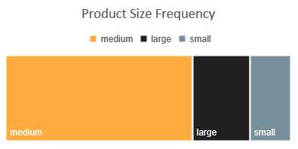
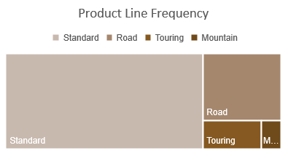
Note: The data and information in this document is reflective of a hypothetical situation and client. This document is to be used for KPMG Virtual Internship purposes only.
Data Exploration
Product Line and Product Size
Frequency
From the Product Line chart, the standard Product has been purchased more by customers While in terms of the product size, the Medium size leads the way.
Hence the best movers from the both charts should be used as a means to target new potential customers

Slide 10
Note: The data and information in this document is reflective of a hypothetical situation and client. This document is to be used for KPMG Virtual Internship purposes only.
Data Exploration
State Vs Car Analysis
From the Table to the right, New South Wales and Victoria leads with the number of people with cars and without cars. Therefore, we are targeting customers from NSW and VIC.
State | Number of cars owned | Number of cars not owned
NSW | 5465 | 5201
VIC | 2425 | 2596
QLD | 2133 | 2129

Slide 11
Note: The data and information in this document is reflective of a hypothetical situation and client. This document is to be used for KPMG Virtual Internship purposes only.
Model Development
High Value Customers To Generate Most Value in the Organization
For targeting High Value customers, the following model has been developed;
They are between ages 40-49
Customer Segment are the mass customers.
They are mostly females( males too can be included since it is a 1% difference)
They work in the manufacturing, Financial services and Health Industry.
They Live in New South Wales and Victoria.

Slide 12
Note: The data and information in this document is reflective of a hypothetical situation and client. This document is to be used for KPMG Virtual Internship purposes only.
Interpretation
High Value Customer Summary Table
customer id | first name | last name | gender | past 3 years bike related purchases | Age | job industry category | wealth segment | owns car | State
2 | Eli | Bockman | Male | 81 | 42 | Financial Services | Mass Customer | Yes | NSW
27 | Garvin | Klees | Male | 37 | 44 | Health | Mass Customer | Yes | NSW
42 | Chiquita | Durnall | Female | 24 | 46 | Manufacturing | Mass Customer | No | NSW
50 | Whitby | Schapero | Male | 38 | 42 | Manufacturing | Mass Customer | Yes | VIC
87 | Fields | Langdon | Male | 78 | 49 | Financial Services | Mass Customer | No | NSW

Slide 13
Note: The data and information in this document is reflective of a hypothetical situation and client. This document is to be used for KPMG Virtual Internship purposes only.
Appendix

Slide 14
Note: The data and information in this document is reflective of a hypothetical situation and client. This document is to be used for KPMG Virtual Internship purposes only.
Appendix
Independent Variables To Generate the Most Value in the Organization
The following are the analysis for the independent variables;
The Most purchased brand by the customers are the Solex, Giant Bicycles and weareA2B
That purchased the standard product Line
With sizes medium.

